Slide 1
Microsoft 365 SMB Masters Professional
Sales & Technical Professional Badge
Instructions
May 2023

Slide 2
Microsoft 365 SMB Masters Program Overview
The Microsoft 365 SMB Masters Program is designed to enhance technical expertise and sales capabilities for our SMB partners. Through live and on-demand webinars, along with immersive in-person training, the program has a proven track record in helping boost customer acquisition and upsell proficiencies. Leverage the program to:
Learn more about how to position the value of Microsoft 365.
Expand deployment, configuration, and management capabilities around Microsoft 365.
Gain useful insight into Microsoft tools and programs to enable sales growth and technical practices.
Partners interested in solidifying their proficiency and earning their LinkedIn Badge can find the instructions to do so in this presentation.

Slide 3
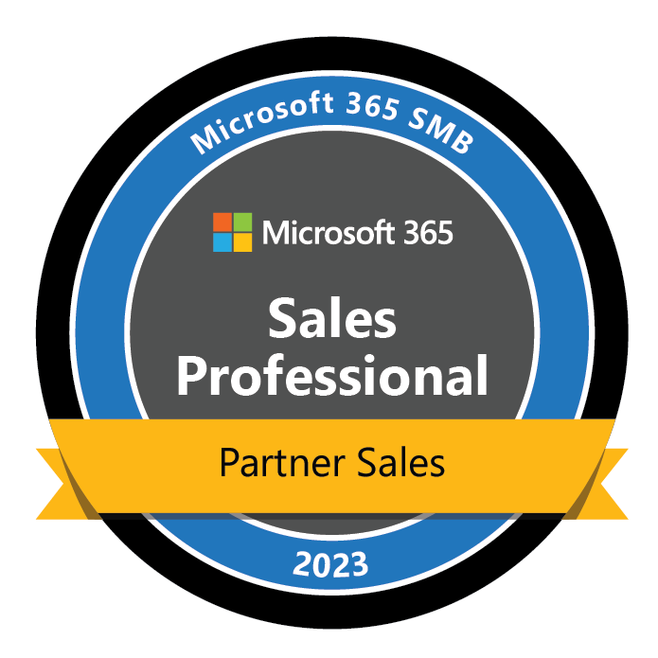
Sales Professional videos and presentations
Overview: The following are the instructions for earning your Sales Professional Badge. The videos and presentations links below help you prepare for the knowledge check and serves as a quick reference. For those partners preferring to access these through Readiness Hub; the Sales series learning path is available.
How to earn your badge
Sales Series: Videos and Presentations
Prepare– Watch and learn as you review of the Microsoft 365 Sales series
Complete knowledge check – Take the Sales Professional exam. Earn your badge with a score of 80% or greater.
Submit for your badge– Upon passing, you will receive a link to complete a form. From there, you will gain access to your LinkedIn badge.
Good luck!
Renew and Upsell SMB Customers with Microsoft 365 Business and Microsoft Defender for Business
How to land the value proposition of Teams and help customers succeed with hybrid work
Use the AI-driven Insights of Sales Advisor (former Project Orland) for Microsoft 365 to Grow Your Business
Video
Video
Video
Presentation
Presentation
Presentation
SMB Masters Program Go-to-Market Best Practices
How to capitalize on the new Cloud PC category to help customers do more with Windows 365
SMB Masters program Security Sales Training
SMB Masters program introduction
Video
Video
Video
Video

Slide 4
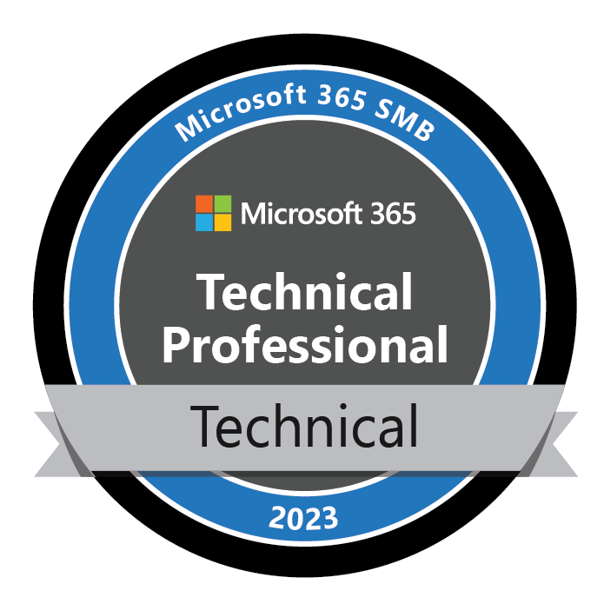
Technical Professional videos and presentations
Overview: The following are the instructions for earning your Sales Professional Badge. The videos and presentations links below help you prepare for the knowledge check and serves as a quick reference. For those partners preferring to access these through Readiness Hub; the Technical series learning path is available.
How to earn your badge
Technical Series: Videos and Presentations
Prepare– Watch and learn as you review of the Microsoft 365 Sales series
Complete knowledge check – Take the Sales Professional exam. Earn your badge with a score of 80% or greater.
Submit for your badge– Upon passing, you will receive a link to complete a form. From there, you will gain access to your LinkedIn badge.
Good luck!
Practical Guide to Onboarding Customers to Microsoft Defender for Business
Practical Guide to Building Managed Security Services with Microsoft 365
Add Structure and Credibility to Your Security Portfolio with CIS Controls v8 Cybersecurity Framework
Video
Video
Video
Presentation
Presentation
Presentation
Secure Devices in a Hybrid Environment
Configure, Manage, and Provision Windows 365
Add a Modern, Cloud-based Phone System to Microsoft Teams
Adapt to the Needs of Hybrid Work with Teams Rooms and Apps
Video
Video
Video
Video
Presentation
Presentation
Presentation
Presentation

Slide 5
Thank you

