Slide 1

A new way of doing business
Why now is a good time to upgrade from
Skype for Business Online to Microsoft Teams

Slide 2

Transforming workplace collaboration is a business imperative
86%
of leaders cite lack of collaboration or ineffective
communication top reason for workplace failures
65%
of leaders agree that moving from hierarchical
to team-based working is critical for their success
in 2019, but only 7% say they are ready
45%
of leaders have or are implementing web-based
collaboration solutions at scale in their companies
Notes:
Transforming workplace collaboration is a business imperative. Your competition moves fast; and reducing cycles and increasing the quality of collaboration in your organization can be a major differentiation to drive growth.
In fact, 86% of leaders cite the lack of collaboration or communication as the top reason for workplace failures.
And the transformation is already happening. 45% of leaders have or are implementing web-based collaboration solutions as scale in their companies.
While many productivity apps exist for the workplace, what is lacking are tools to make teams of people more productive together. And 65% of leaders agree that moving from hierarchical to team based working is critical for their success in 2019; but only 7% say they are ready to do so.
63% --- https://futurumresearch.com/wp-content/uploads/2019/03/DXC-Workplace-Digital-Transformation.pdf?utm_campaign=213902_DXC%20Workplace%20%26%20Digital%20Transformation%20Insights&utm_medium=email&utm_source=Futurum%20Research&dm_i=4R13,4L1Q,2T6UU9,FNKT,1
47% -- https://hbr.org/resources/pdfs/comm/hp/HPWorkforceEngagement.pdf
https://www.mckinsey.com/business-functions/digital-mckinsey/our-insights/advanced-social-technologies-and-the-future-of-collaboration
https://www.gallup.com/workplace/231581/five-ways-improve-employee-engagement.aspx
https://hbr.org/resources/pdfs/comm/microsoft/workplaceevolution.pdf
https://www.mckinsey.com/business-functions/digital-mckinsey/our-insights/how-social-tools-can-reshape-the-organization
https://www2.deloitte.com/content/dam/insights/us/articles/5136_HC-Trends-2019/DI_HC-Trends-2019.pdf

Slide 3
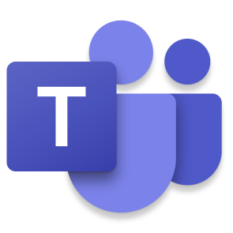
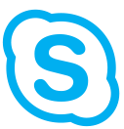
Why upgrade to Teams?
  Advanced features, modern experiences
    Teams combines chat, video, calling, collaboration, and app integration into a single, integrated hub
    State-of-the-art cross-platform and mobile experiences
  Performance by design
    Reimagined client built on cloud infrastructure
    Teams provides improvements in call and meeting quality, and other operational metrics
  Bottom-line benefits
    In a recent study, organizations that moved to Teams
    saw cost reductions from consolidating solutions
    to one platform, had 14.6% less downtime due to
    online availability of resources, and projected
    a three-year net present value per user of $5,416*
    *The Forrester Study: The Total Economic Impact™ Of Microsoft Teams outlines cost savings and other financial benefits organizations can realize by adopting Teams
Notes:
Since launch, we’ve continued to build Teams capabilities and features, enabling users to communicate and collaborate in new ways, making their organizations more efficient, more nimble, and more secure. Teams’ improved call, chat, and meeting experiences have the potential to impact the bottom line. The Forrester study, “The Total Economic Impact of Microsoft Teams” calculates the broad benefits organizations have realized from moving to Teams.
Because Teams functionality extends beyond Skype for Business Online, we’ve announced a July 31, 2021 retirement date for that service. In this presentation, we’ll cover the journey from Skype for Business Online to Teams, and discuss the Teams resources available to help make the transition smooth and successful.

Slide 4
Skype for Business Online retirement
    Skype for Business Online will
    be retired July 31, 2021
    Skype for Business Server is not affected, but customers with hybrid configurations will need to move Skype for Business Online users to Teams by the retirement date
July 31
2021

Slide 5
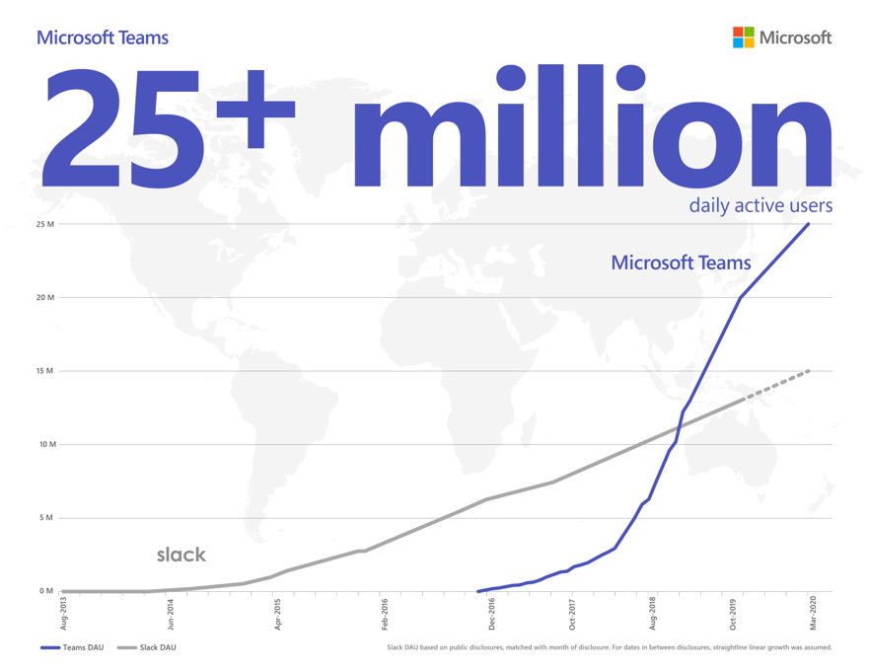

Teams momentum
Daily
Active Users
Meeting participants
in a single day
Teams meeting
minutes generated
75+
200+
4.1+
Million
Million
Billion

Slide 6
Teams yields organization-wide benefits
Accelerate decision making
Reduce the volume of meetings and
make them more efficient
Improve the way people share information
Speed up innovation
Help people work better together
with built-in Office 365 apps
Enable mobility and productivity at scale
Take care of end-to-end security,
administrative control, and compliance
per week
18.9%
4 hours
17.7%
Fewer meetings each week*
Time saved on collaboration and information sharing*
Faster decision making*
    *The Forrester Study: The Total Economic Impact™ Of Microsoft Teams outlines cost savings and other financial benefits organizations can realize by adopting Teams
Notes:
NOTE: This slide may be shared with customers
Teams saves money by improving organizational efficiency, productivity, and speed of outcomes. This concept reflects a critical shift in mindset from viewing Teams as another cost to seeing it as a platform that creates value. The more an organization leans into Teams, the greater the return they may anticipate.

Slide 7
Teams capabilities extend far beyond Skype for Business
Skype for Business offers chat,
meeting, and calling capabilities
Manage
contacts
Chat and
call
Host
meetings
Notes:
Skype for Business has been an invaluable solution for many organizations throughout the years, but its core functionality doesn’t map to the needs of a workforce that is more agile, more geographically distributed, and getting younger.

Slide 8
Teams capabilities extend far beyond Skype for Business
Integrate business applications
Store and share files
Teams is a hub for teamwork,
where people connect, communicate, and collaborate
from within a single interface.
The added functionality of Teams helps streamline the ways your organization works.
Manage
contacts
Chat and
call
Collaborate on documents
Manage projects and work groups
Host
meetings
Notes:
Microsoft Teams extends the capabilities of Skype for Business, bringing together chat, meetings, calling, collaboration, app integration, and file storage into a single interface. This new central hub for teamwork can help streamline the way users get things done, improving user satisfaction and accelerating business outcomes. We’re continually expanding Teams capabilities to enable you to communicate and collaborate in new ways, break down organizational and geographical barriers, and drive efficiency in process and decision making.
Teams isn’t just an upgrade for Skype for Business, it’s a powerful tool that opens the door to an entirely new way of doing business.

Slide 9
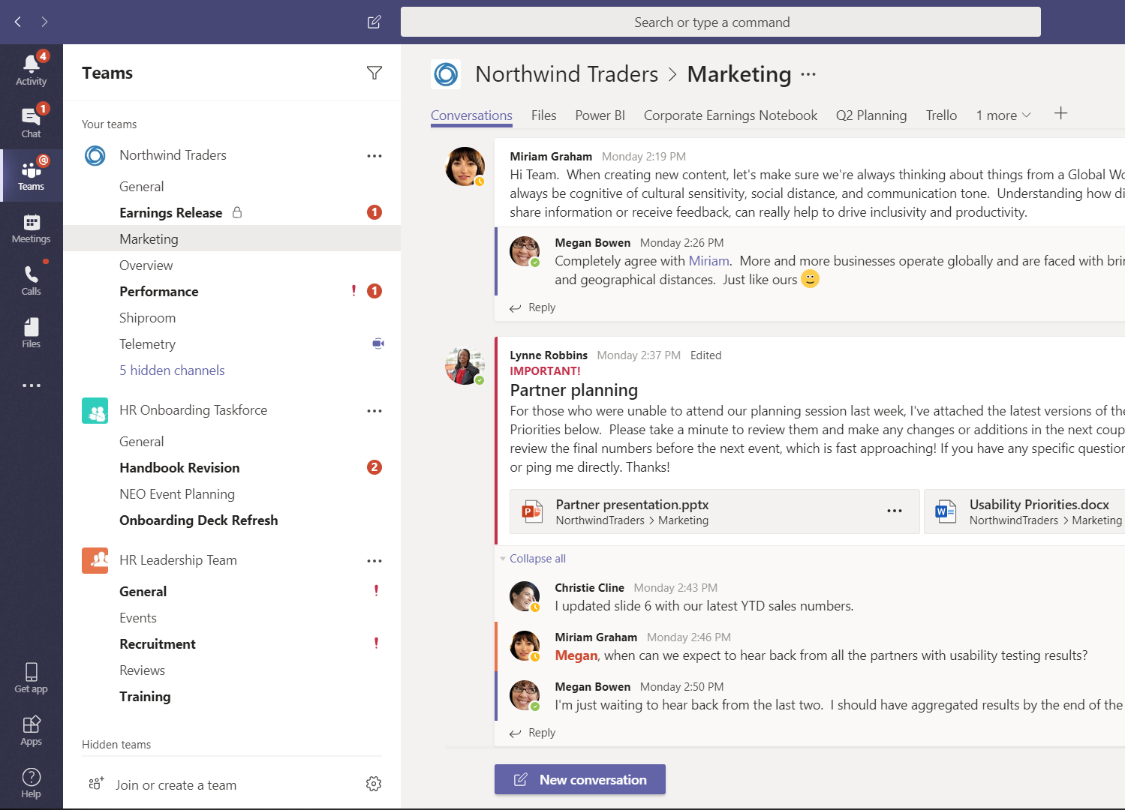
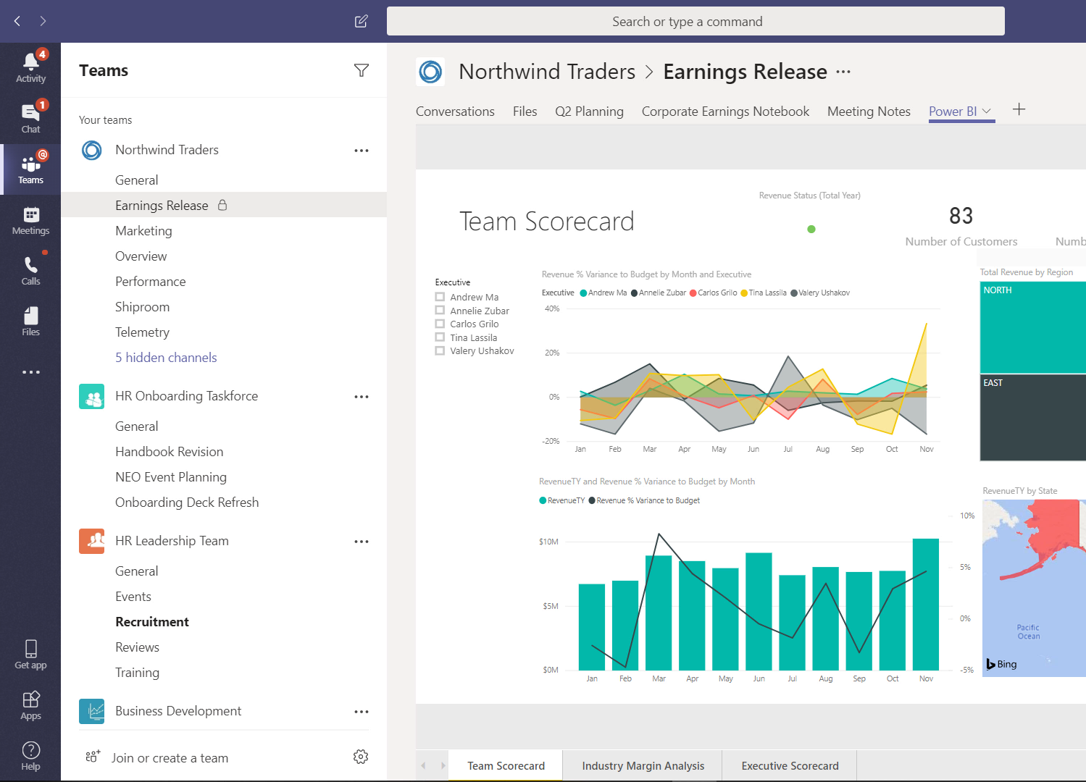
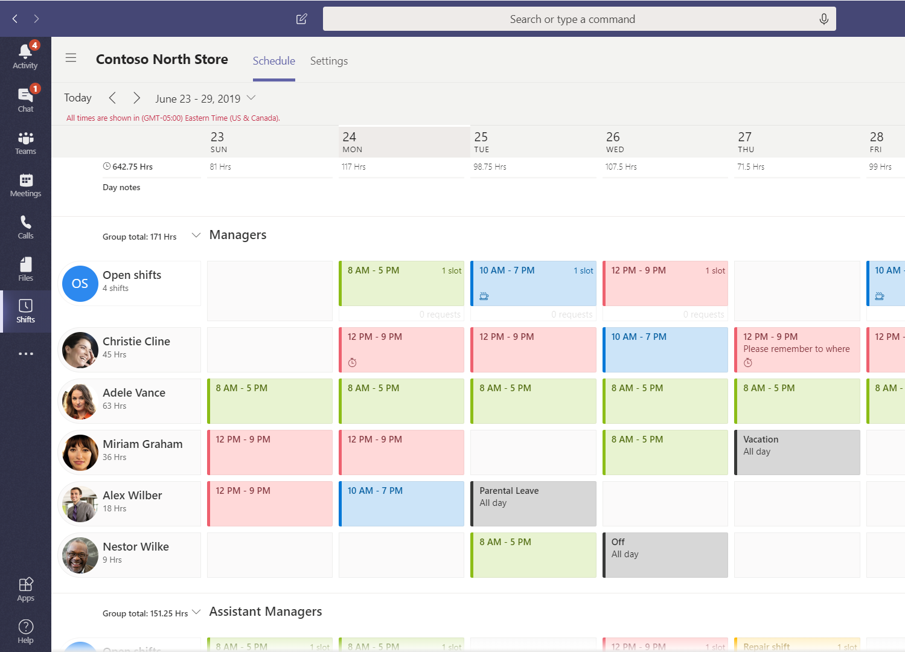
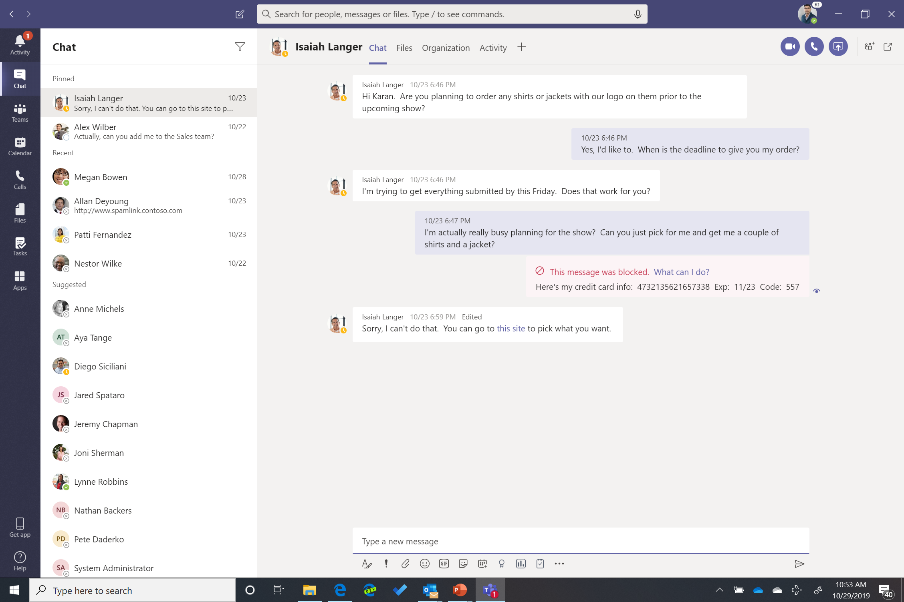

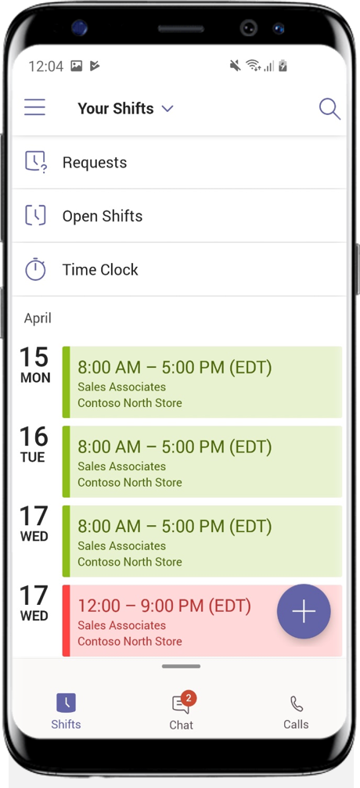
What can Teams do for your business
Transform workplace
collaboration
Streamline business
processes
Connect everyone on
a single platform
Provide enterprise grade security & compliance
Notes:
-- Please note: This is an animated slide that changes on mouse click --
And what does that mean for your business?
It means that Teams can help you…
Transform Workplace collaboration
by bringing everything together into a shared workspace where you can chat, meet, create, and make decisions as a team.
And since all your content is organized by team or project, you are able to stay in the flow of your work. It takes the average person 23 minutes to regain productivity after an interruption, or being distracted.
Streamline business processes
You need ready access to business-critical data, applications, and be able to execute repeatable processes efficiently. Since Teams is a true platform, you can plug in apps and services you already use, and even integrate your existing tailor-made tools INTO Teams.
Imagine being able to seamlessly kick off a repeatable approvals process without ever having to leave Teams.
Connect everyone on a single platform
Teams is just as important and effective a tool for a C-level executive, as it is for somebody on a factory floor, in a retail shop, a classroom, a hospital, in a marketing role, or anyone in between.
We have thought about the unique needs of many different types of workers and provide solutions through Teams that are tailor-made for them. And Microsoft is the only collaboration solution provider who has dedicated engineering teams building functionality specifically for roles across industries.
For example, you can see here how Teams gives Firstline worker managers a tool to manage schedules and gives the workers an easy way to consume that information, or even swap a shift.
Provide enterprise grade security & compliance
As a part of Microsoft 365, Teams provides you the security, compliance, and control you need to run your business– whether a small, agile business, or a large globally scaled enterprise.
1 UC Irvine study, “The Cost of Interrupted Work: More Speed and Stress,” June 2015

Slide 10

Teams benefits your business, end users, and IT leads
Your business
Your end users
IT leads
Faster decision making and accelerated innovation
Reduced email volume and more efficient meetings
Better information sharing
Integration with Office apps
Mobility and productivity
at scale
Meetings start more quickly
Improved video and
sound quality
Co-authoring in real time
Inline message translation
Background blur so you can work from anywhere
Meetings recorded in the cloud
Emojis and GIFs
One integrated platform with end-to-end security and administrative controls
A robust and highly
available solution
Improved performance
with less downtime
Supports tabs, bots,
and connectors
Notes:
Teams delivers value to stakeholders across your organization
Leadership will appreciate the faster decision making, more efficient operations, and cost savings associated from consolidation of communications platforms and tools
End users will appreciate the stability, call, and meeting quality of Teams, the ability to connect and collaborate more efficiently, and delightful features such as background blur, in-line translation, and emojis and GIFs
IT leads will appreciate managing a single platform, the ability to integrate data and applications into the Teams environment, and improved security and admin controls, as well as better meeting and call performance

Slide 11




What we hear from our customers
Digitalization from within – in accordance with regulatory requirements
Working from home
got a whole lot easier
Supporting
sustainability efforts
“In the midst of the COVID-19 crisis, implementing Microsoft Teams provided our workforce with precisely the kind of help they would want from their IT department.“
“Teams became the central communication platform, and the endless strings of emails and conference calls suddenly disappeared.
Our colleagues keep telling us how great it was that we worked with them to make the change so quickly.”
“Before, I had to be in the same room to communicate with my coworkers. Using Teams chat is much easier, and it’s the way that our younger coworkers expect to communicate, so it makes working here more appealing for them.”
Alexander Strothmann
Johannes Stoll
Fabian Haeberlein
IT project manager for collaboration
Head of IT
Deputy Marketing Manager
Find more customer stories at https://customers.microsoft.com/de-de/home
Notes:
It’s incredible to hear about the many different ways customers have used Teams to transform the way work gets done and produce better outcomes.
Microsoft Teams helps them to enable efficient ways or working. It helps teams to be more collaborative, work in the open with everybody in the know, democratizing information and decision making.
It helps them to accelerate decision making. In Microsoft Teams, information is shared in the moment and with context, enabling people to quickly make an informed decision.
Microsoft Teams is also a driver of digital transformation by helping our customers to modernize business processes and align them with how people work in the modern workplace.

Slide 12
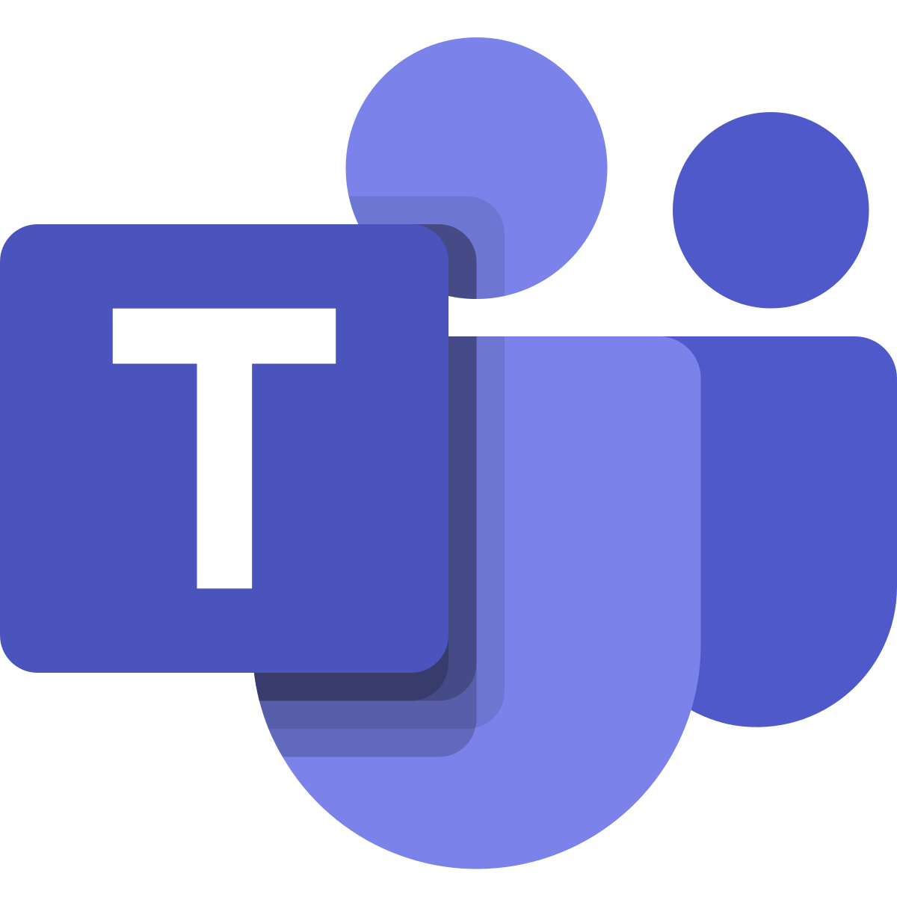


Journey from Skype for Business to Teams
Driving adoption for key scenarios in Teams is critical to success
Envision teamwork for your organization
Pilot Teams
Deploy Teams
Grow Teams adoption
Plan your upgrade to Teams Only
Upgrade to Teams Only
+
1
2
3
4
5
6
Skype for Business
Coexistence
Teams Only
Organizations not yet using Teams start here
Focus: Drive adoption in Teams while continuing to use Skype for Business, then focus on upgrade
Organizations already using Teams start here
Focus: Plan for and implement the upgrade to Teams Only mode
Notes:
One of the top success factors for customers who have completed the upgrade journey to Teams is to first ensure Teams is widely adopted across your organization for the scenarios that matter most to you.
With that in mind, the starting point for a full upgrade to Teams will vary based on where you are in your path to Teams.
For organizations who have not yet started using Teams, the first step is to create a vision for teamwork in your organization and how Teams enables that. Then start onboarding and driving adoption in Teams for those scenarios.
For organizations who have already started using Teams and have helped users adopt Teams for key scenarios, we recommend planning your upgrade to Teams Only and offboarding from Skype for Business.
This is a simple mapping of the journey to Teams Only. We have guidance, best practices, and resources to help organizations each step along the journey.

Slide 13






Planning for a successful upgrade
Once you plan your upgrade to Teams only, use this proven framework for driving technical and behavioral change. Each step in the framework builds on the step prior and, for optimal results, we recommend following the steps in order.
+
Project stakeholders
Project definition
Technical readiness and user readiness
Deployment and implementation
Operational excellence
Gather the right sponsors and project team
Define your project scope, goals,
and timeline
Assess network readiness;
test for quality
Assess user acceptance and design readiness
Implement pilot, coexist, and upgrade strategy
Drive value through optimization and adoption growth
Learn more at aka.ms/SkypeToTeams
Notes:
A successful upgrade from Skype for Business to Teams involves planning for technical aspects of your upgrade as well as encouraging user adoption of Teams. Together they help ensure a positive user experience and enable you to achieve your desired business outcomes.
Our online upgrade guidance is built upon a proven success framework that reflects change management best practices, experience, and learning based on years of successful deployments across solutions, industries, and organization size.
This framework also reinforces key attributes of our most successful customers.
Enlist your project stakeholders
Any successful project begins by bringing together the right stakeholders: the individuals who have a "stake," or need to be involved in planning and execution. Ensure your upgrade project team includes Executive Sponsors representing Business and IT, as well as designated IT Pro, Admin, and User Readiness leads.​
Define your project scope
Taking time to define key project logistics including scope, business goals, success metrics, risks, and timeline will help ensure all stakeholders are aligned and working towards the same priority outcomes.
Plan for technical and user readiness
The ideal upgrade approach addresses two critical planning areas: technical readiness and user acceptance.
​By confirming that your environment is set up for success with Teams, you help ensure consistent, high-quality experiences. Through the understanding of your user communities and designing the right readiness plan, you help facilitate the desired behavior change, accelerating adoption and increasing value realization for both users and the organization as a whole.
Implement your upgrade
You have flexibility in how and when you upgrade your organization to Teams. By piloting Teams, running Skype and Teams together in your environment, and then moving users fully to Teams in a manner that best fits your use cases and goals, you ensure the best experience with minimal business disruption for users.
Maximize your long-term success
An operations strategy that includes regular network monitoring and user satisfaction measurement is the best way to ensure consistent quality experiences, sustained adoption growth, and maximum business value realization. Ongoing optimization of your environment will ensure you build on your upgrade success and enable users to explore additional use cases in Teams.

Slide 14

Identify Teams champions and critical stakeholders
Understand the
impact of change
Assess the impact to the organization, and reflect it in the adoption plan
Build user engagement into your communications plan
Use cases and role-specific benefits help users understand the value of Teams
Pilot before rolling
out broadly
Identify early adopters and evangelists to champion
deployment and provide feedback
Target users and departments
with unique needs and edge-case requirements
Evaluate awareness building, training, and support, then iterate based on feedback and analysis
Focus on driving
sustained results
Frequently communicate project progress, to-dos, and next steps
Consider devices as part of your overall strategy, including personal computers, meeting room systems, and peripherals
Notes:
Assessing the requirements and motivations of stakeholders would seem like an obvious step in a successful project plan, but it frequently doesn’t get the time and attention it deserves. Identifying your advocates and critical paths to success will help showcase the value and the rationale for new tools and processes.
They can also help provide feedback on awareness, training, and support planning and scale throughout the organization.

Slide 15

Webinars (German)
    These webinars help you prepare for your transition
    from Skype for Business to Microsoft Teams.
Realizing the full potential with Microsoft Teams
In this webinar, we will introduce you to the types of applications in Teams and app templates with which you can extend the functional scope of teams.
View now
Transitioning from Skype for Business to teams
This web talk will show you ways to move from Skype for Business to teams. We will help you to identify and overcome possible hurdles.
View now
How companies successfully implement Microsoft Teams
In this webinar, we will show you why change management is important in the adoption of Microsoft teams, and how other customers have adopted this tool and ensured its continued use in the organization.
aka.ms/Transition-FAQs

Slide 16

Live planning workshops and training
    Microsoft will help you design a strategic plan based upon a proven change management framework and the specific needs of your organization.*
Upgrade planning workshops
Free interactive online workshops packed with guidance, best practices, and resources designed to kick-start planning and implementation
aka.ms/SkypeToTeamsPlanning
Teams live training
Free live and on-demand online training classes designed to help get business decision makers, admins, IT Pros, and end users up and running with Teams.
Microsoft Teams
Chalk Talks
Free online workshops to learn best practices and practical guidance around the most popular and compelling scenarios in Teams.
aka.ms/TeamsLiveTraining
Online upgrade guidance
The A-Z for upgrade planning and deployment includes a proven upgrade framework and timelines, coexistence guidance, and an upgrade success kit
aka.ms/SkypeToTeams
aka.ms/TeamsChalkTalks
*All customers have access to online tools and training. FastTrack-led engagements are available for qualifying customers.
Notes:
Have questions about the move to Teams? Ask away. Our live Teams training and upgrade planning workshops are a great way to learn strategies for success.

Slide 17

Online resources
Upgrade Framework
The Upgrade Framework will guide you through the process
of upgrading to Teams based on your business scenario.
aka.ms/Upgrade-Framework
Best Practices
Best practices, tools, and resources to help you make a successful
transition to Teams.
aka.ms/Transition-to-Teams
Transition FAQs
A comprehensive collection of FAQs regarding the transition from Skype for Business to Microsoft Teams – from general questions to specific capabilities.
aka.ms/Transition-FAQs
Video series
In the "Teams IT Pro Academy: Skype for Business to Microsoft Teams", learn
why to upgrade (part 1), how to upgrade (part 2), learn about coexistence and interoperability (part 3) and about the Administrator's upgrade experience (part 4).
Notes:
Have questions about the move to Teams? Ask away. Our live Teams training and upgrade planning workshops are a great way to learn strategies for success.

Slide 18
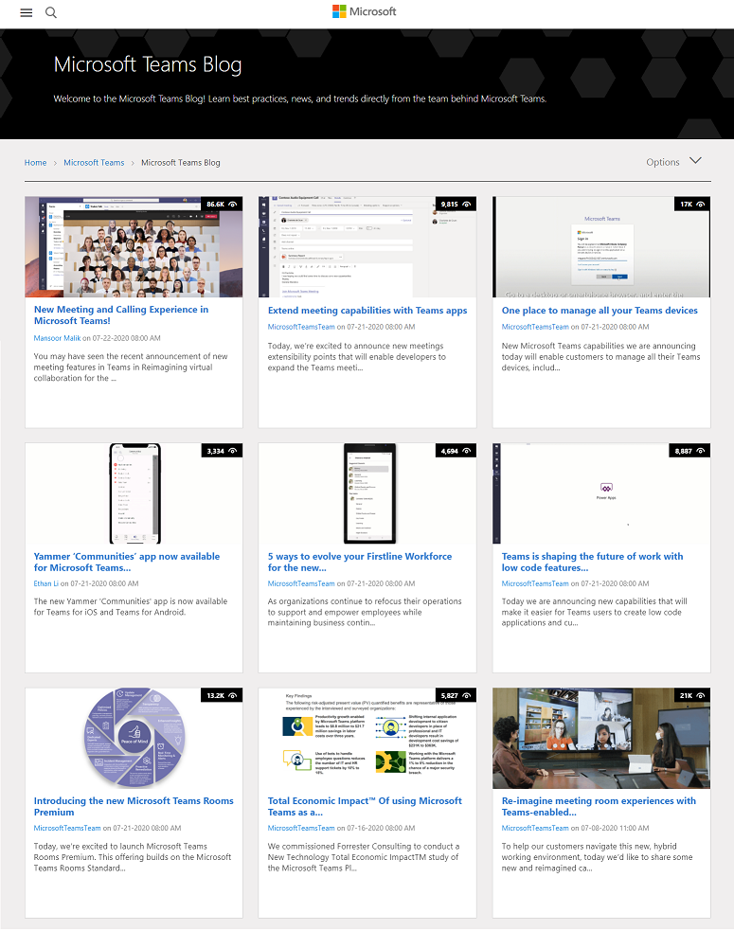
Microsoft Teams blog and Teams upgrade forum
Teams upgrade blog posts
  Five tips for planning a successful upgrade to Teams 🌐
  Resources to help customers with upgrade from Skype for Business to Microsoft Teams 🌐
  Why wait? The top 10 things you need to know about upgrading from Skype to Teams 🌐
  Skype for Business Online to be retired in 2021 🌐
  Meetings First brings Microsoft Teams meetings to Skype for Business Server customers 🌐
  Visit the Microsoft Teams Blog
Skype for Business to Teams upgrade forum
  The Skype for Business to Teams upgrade forum on Tech Community is a great place to ask questions, share feedback, and learn from other IT professionals how to get the most from Microsoft Teams.
  Join the conversation

Slide 19
Thank you!
© 2020 Microsoft Corporation. All rights reserved. Document accurate as of April 2020 and provided “as-is.” This document is for informational purposes only.
© 2020 Microsoft Corporation. All rights reserved. Document accurate as of April 2020 and provided “as-is.” This document is for informational purposes only.

